Slide 1

Strategic Assessment of Food Business A Data Science Approach
Sumeet Shinde
Mayank Jaggi
Akshay Kadu
Gaurav Burman

Slide 2
A Strategic Business Assessment for investing in a new Burrito and Taco restaurant
Optimum location
Strategic Pricing
Best Category of Restaurant

Slide 3
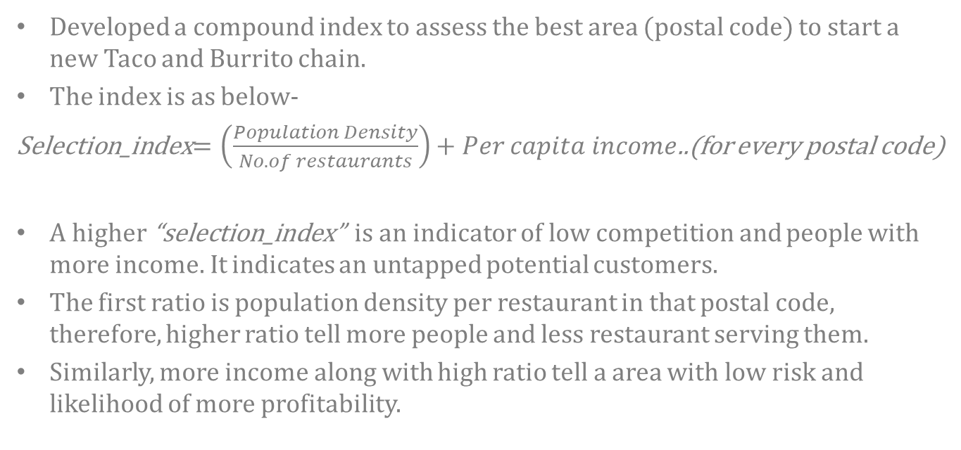
Assessment index to select location
Developed a compound index to assess the best area (postal code) to start a new Taco and Burrito chain.
The index is as below-
Selection_index$=\left(\frac{Population Density}{No. of restaurants}\right)+Per capita income$..(for every postal code)
A higher “selection_index” is an indicator of low competition and people with more income. It indicates an untapped potential customers.
The first ratio is population density per restaurant in that postal code, therefore, higher ratio tell more people and less restaurant serving them.
Similarly, more income along with high ratio tell a area with low risk and likelihood of more profitability.

Slide 4
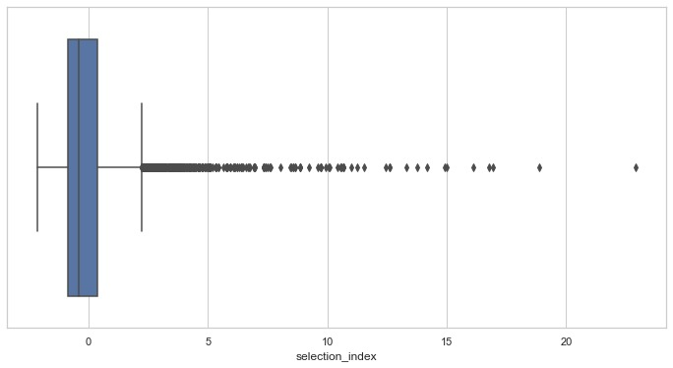
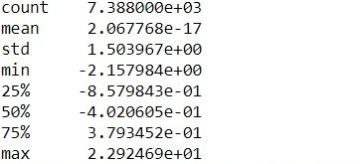
Assessment index to select location
We recommend to have selection_index above 0.379 as its lies above 75th Percentile which could be considered as low risk zone.

Slide 5
An interesting outlier!!
Queen New York, 11109!!
It has a Selection_index of 16.92

Slide 6
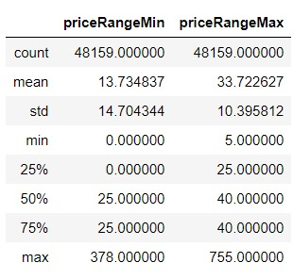
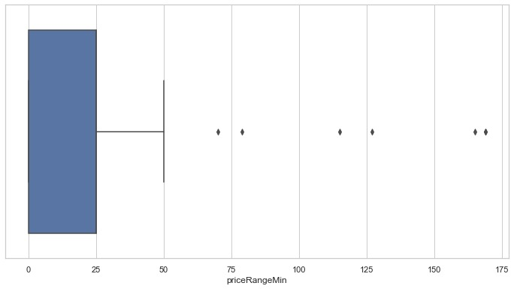
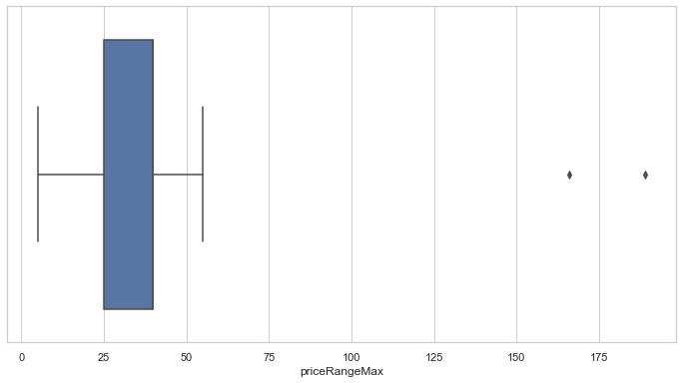
Strategic Price model
After analyzing all the available “Prices” of all the restaurants in US we found the percentile ranges. We recommend pricing the burritos and tacos within the interquartile range of the Max and Min prices across US.

Slide 7
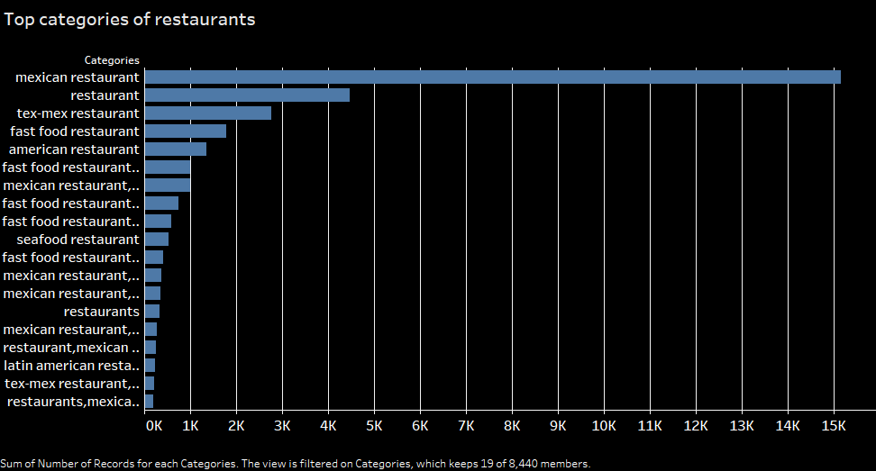
Category of Restaurant that are most preferred for Burritos and tacos

Slide 8
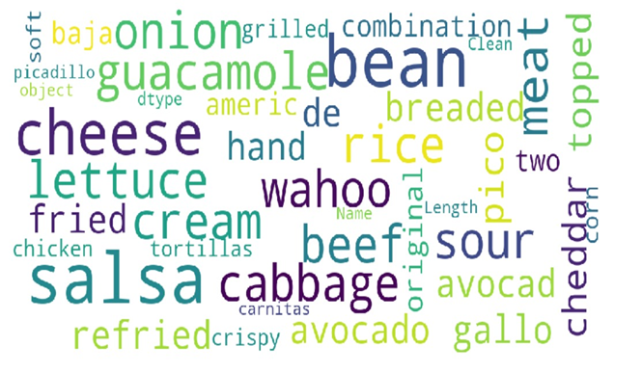
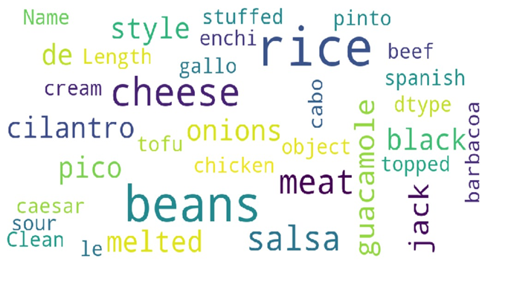
Popular Ingredients of Burrito and Taco
Taco
Burrito

Slide 9
Challenges
Heavy Pre-processing was required to bring data integrity for example- large variation was present in the name of the restaurant across the dataset.(lowercase, uppercase, hypen, apostrophe, etc.)
Sales data was not provided, the amount of sales was gauged from the popularity of the restaurant
External data sources such as per capita income and population density were used to derive insights

Slide 10
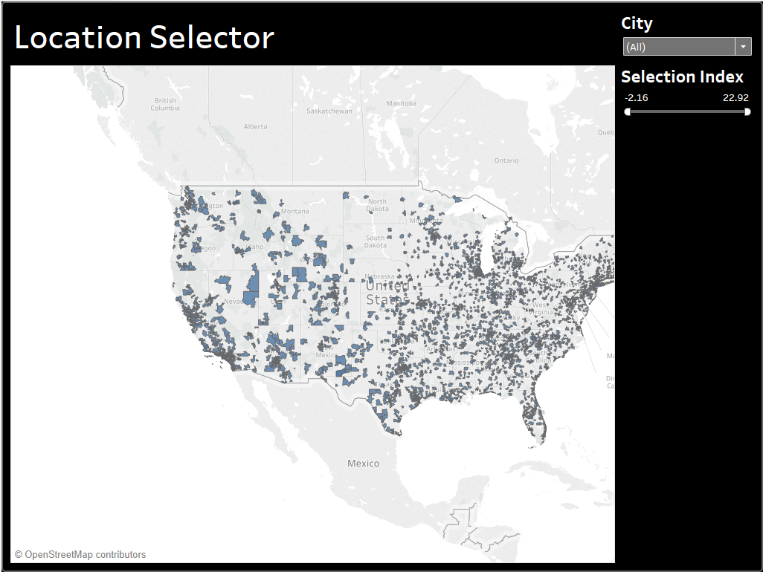
Dynamic Postal Code selector dashboard

Slide 11
References
Fact finder- America- (https://factfinder.census.gov/faces/nav/jsf/pages/index.xhtml)
Simplemaps.com (https://simplemaps.com/data/us-zips)

